Slide 1
Groot
Extracting the Book and Writer's name from the
cover image of the book(English)
Student: Sandeep Kr. Nagar
2018701015

Slide 2
Contents
Introduction
Requirement Description
Work achieved
Results
Summary and Further work

Slide 3
Introduction
In this project, the input is the photo of book cover images and the output is
the text containing the text on the image including the writer name and book's
name with other book information related to the book on the cover image of
the book.

Slide 4
Intro (cont.)
The main objective of the project is to extract the text from the image of the Book cover(English).
To achieve this i have done Preprocessing ,Edge detection, Binarization and Morphological operations.

Slide 5
Requirement
To complete the goal of the project, we have use some predefined functions of image processing in opencv python and Tesseract python library.
Python-3.
OpenCV.
Some more Libraries.

Slide 6
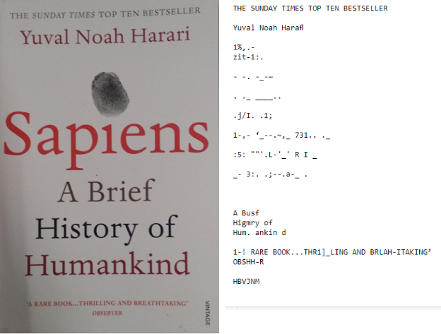
Work Achieved
In the project we have extracted text from multi colour image(book cover) with the help of preprocessing of image which helps in improving the results with better results using classical image processing Method and Tesseract.

Slide 7
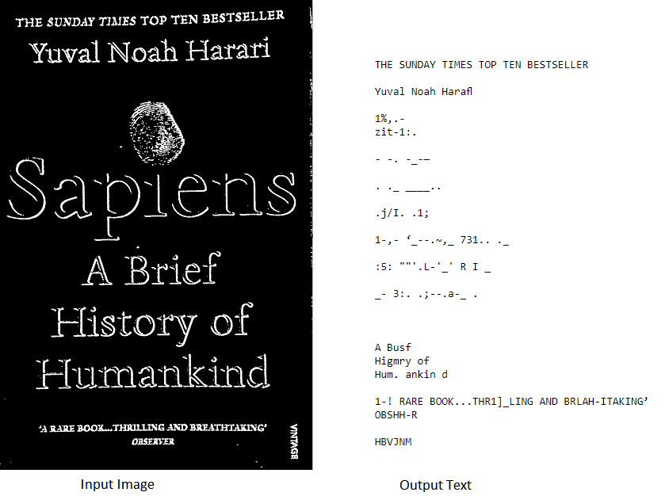
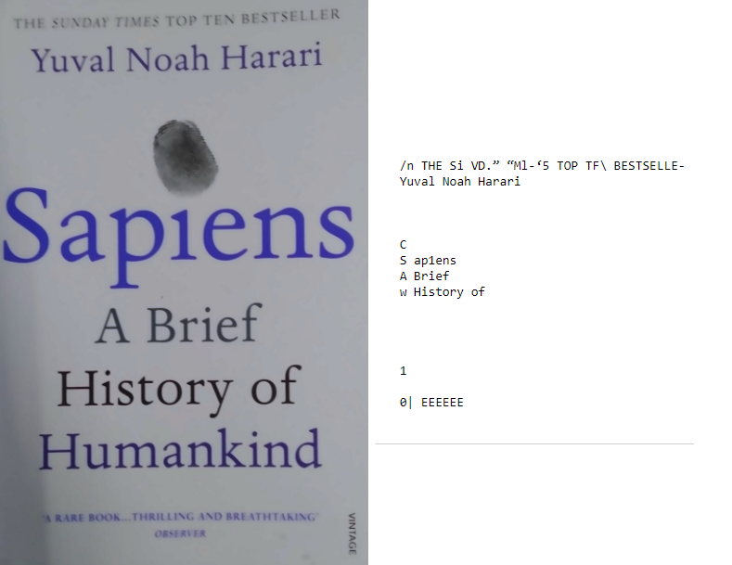
Before and After results.

Slide 8
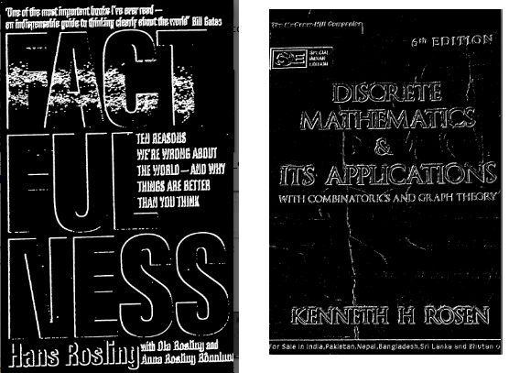
Failure Cases
When the background and text colours are similar
When image is more complex in term of the structures.
Overlapping of text and the non-interesting structure

Slide 9
Summary and further works
To improve the result and generalize the method we can do some more processing like Haugh transformation to find out the connected edges of the text from the disconnected.
We can use some more method to separate the interest region from the other region.
Also we can apply some method of thresholding which can help separating Foreground and Background which can improve the result.

Slide 10
Thank You

